Slide 1

Mathematical modelling for vaccine-preventable diseases
Andrew J K Conlan
University of Cambridge
ajkc2@cam.ac.uk
Notes:
Introduce who we are

Slide 2


Course Introduction & Welcome
Andrew J K Conlan
University of Cambridge
ajkc2@cam.ac.uk
CEMA, University of Nairobi, September 9th -14th 2024

Slide 3

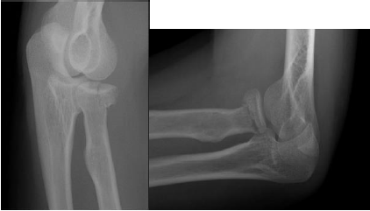
Input:
Cambridge University academic has a cycle accident on his way to work, flying over his handlebars.
Output:

Slide 4
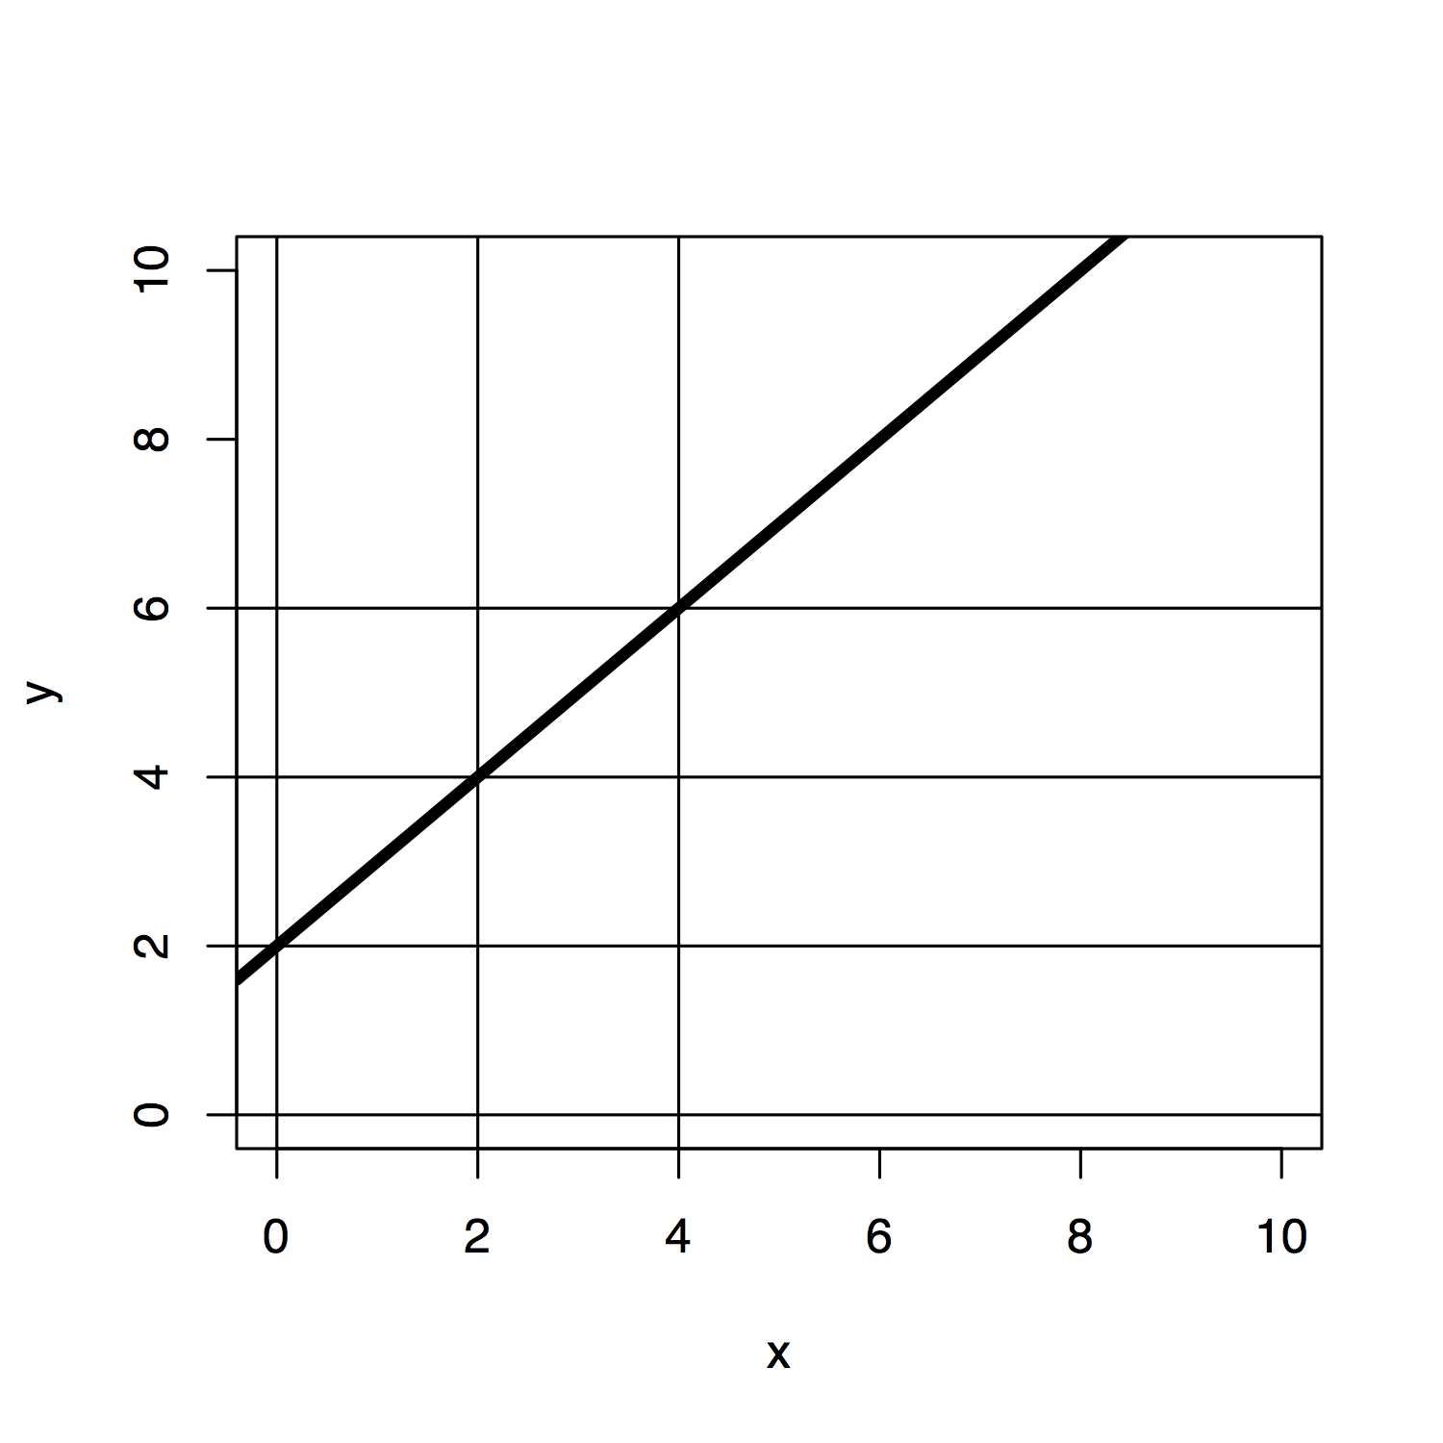
What is a mathematical model?

Slide 5


What is a mathematical model?

Slide 6
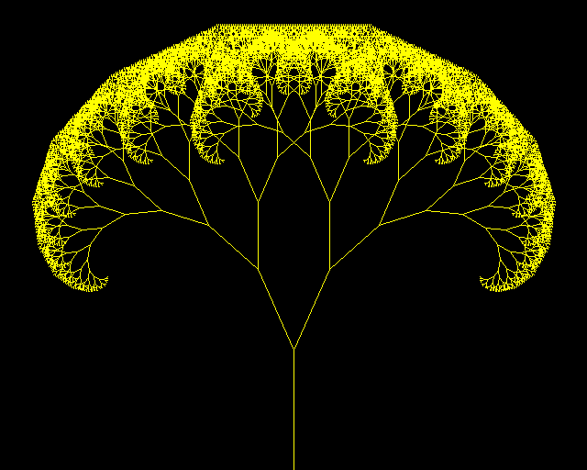
What is a mathematical model?
1)
Draw the trunk
2)
At the end of the trunk, split by some angle and draw two branches
3)
Repeat at the end of each branch until a sufficient level of branching is reached
http://rosettacode.org

Slide 7
What is a mathematical model?
A mathematical model is a description of the behaviour of a system using mathematical concepts or language
All models are wrong, some are useful…
A good (i.e. useful) model provides insights into a system that go beyond the assumptions we use to construct it
A good model provides something new…

Slide 8



The scientific method

Slide 9
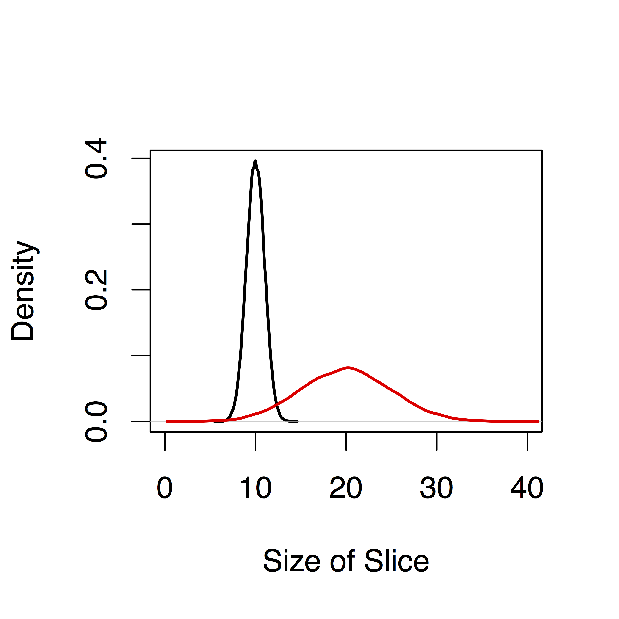
Statistics
The study of observational data
R.A. Fisher
Populations and Variation
Reduction of Data (Parameters)
Mathematical models describing the variation in populations

Slide 10
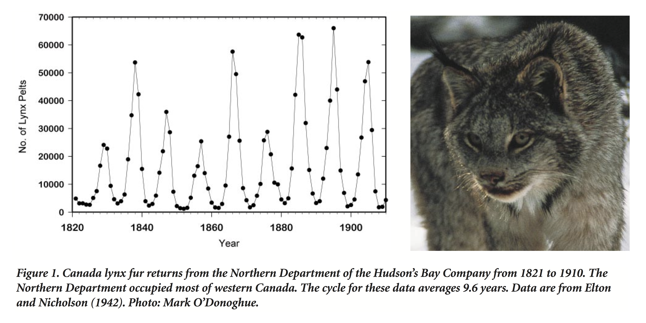
Populations are dynamic
BioScience (2001) 51 (1): 25-35

Slide 11
Simple interactions can generate complex dynamics
Growth rate of Lynx population (L) depends on supply of food (H)
Death rate of Hare’s (H) depends on number of Lynx (L)
Hare
Lynx

Slide 12
Mechanistic models can forecast the evolution of populations rather than merely extrapolate from past behaviour

Slide 13

Dynamic models are essential to predict the impact of vaccination

Slide 14

The predictive power of a model depends on
Identifying the mechanisms driving the behaviour of our system
The evidence we use to design and estimate our model
010010010010001
001001000100010
001010010010101
Data
Models
Prediction

Slide 15


Types of evidence used in disease dynamic models
Observational Data
Experimental
Data
“Expert” Opinion

Slide 16
Course Objectives
Introduce you to the use of mathematical models for disease dynamics
What they are
How they work
How to apply them
How to estimate them from data
Provide you with the conceptual and practical tools to develop models for your own research

Slide 17
What to expect
5 main topics
Mathematics: Calculus, differential equations, probability
Programming in R: Basics, loops and functions
Dynamic Models: Basic population models, linking models to data
Epidemic Models: Deterministic theory, stochastic models, structured models, R₀
Statistics: Inference, likelihood and Bayesian methods

Slide 18
What to expect
Practical sessions are at the heart of the course giving you hands on experience of writing, running and analyzing disease dynamics models
Lectures introduce new topics
“Build your own model” sessions for catch-up, ad-hoc support on R and to discuss your own models
Invited seminars as motivational case studies
Dr Bernhard Bett, ILRI
Dr Cameline Orlando, Kenyan #mathsqueen
Dr John Ojal, KEMRI
Dr Njoki Kimani, CEMA

Slide 19
Housekeeping
Day starts promptly at 8.45
10.45 – 11.00 Coffee Break
13.00 – 14.00 Lunch
16.00 – 16.15 Tea Break
Day ends at 18.00
When possible Q&A time from18.00-19.00
Celebratory Dinner on Friday Evening
Course ends Saturday 18.00 after final Seminar
Now: Speed Networking!

